Slide 1
Robustness of GAN-based image generators against adversarial attacks
Artur Sidorenko¹; Natalya Denisenko²; Alexey Mironov²; Denis Derkach, PhD²; Nikita Kaseev²; Andrey Ustushanin²
¹Moscow State University, ²Higher School of Economics

Slide 2
Private datasets cannot be outsourced, but one can generate synthetic data via a GAN
Neural network
Synthetic data
Third party
Private data

Slide 3
An adversary can subvert the GAN to get information about the private dataset
Neural network
Synthetic data
Third party
Private data
?

Slide 4
GANs are highly effective, but they should not disclose private information
Generative Adversarial Network (GAN) has proven to be a highly efficient technology. It shows remarkable results in a wide range of applications.
However, sufficient and representative datasets are prerequisite for successful training of a GAN. These datasets are often crowdsourced and outsourced and may contain private information. These models must not expose private information because disclosure of such data is treated as a breach of law.

Slide 5
Cheap but good solutions can be helpful
In this research study, we investigate attacks against generative models proposed in [1]: given a record, the adversary determines if it was present in the training dataset. These attacks are aimed at detecting any disclosure of personal data.
We have discovered that even a simplistic GAN can be potent to secure private information if one follows recommendations given in [1].
J. Hayes , L. Melis , G. Danezis, E. De Cristofaro. LOGAN: Membership Inference Attacks Against Generative Models. Proceedings on Privacy Enhancing Technologies, 2019(1), pp.133-152
5. Pretrained DCGAN for MNIST: https://github.com/csinva/gan-vae-pretrained-pytorch/tree/master/mnist_dcgan

Slide 6
Research structure: training two networks and imitating different types of attacks
Training two neural networks: DCGAN [5] and Vanilla GAN (a simple sequence of convolutional layers).
Imitating typical attacks: white-box, black-box with and without leakage.
White-box attack: given discriminator reveal if a given image is a part of the training set.
Black-box attack with leakage: training a home-made classifier using leakage and artificially generated images.
Black-box attack without leakage: training a home-made GAN.
J. Hayes , L. Melis , G. Danezis, E. De Cristofaro. LOGAN: Membership Inference Attacks Against Generative Models. Proceedings on Privacy Enhancing Technologies, 2019(1), pp.133-152
5. Pretrained DCGAN for MNIST: https://github.com/csinva/gan-vae-pretrained-pytorch/tree/master/mnist_dcgan

Slide 7
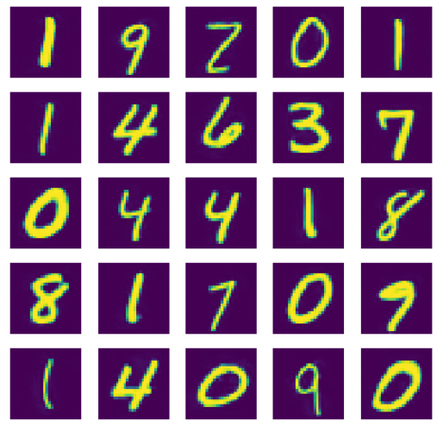
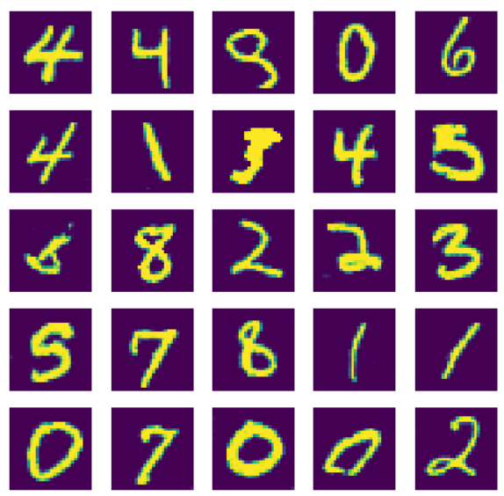
We trained a simplistic GAN and employed a pre-trained DCGAN [5]
The structure of our vanilla GAN
Generarator
Discriminator
Dense (ELU)
Dropout
Conv2d (kernel_size=3, ELU)
Dropout
ConvTranspose2d
Dropout
Conv2d и Dropout
Conv2d и Dropout
Conv2d (ELU, kernel_size=3)
Dropout
MaxPool2d(2)
Conv2d(ELU,kernel_size=3) и Dropout
Conv2d(ELU,kernel_size=3) и Dropout
Conv2d(ELU,kernel_size=3) и Dropout
Linear() with sigmoid
Vanilla GAN
DCGAN
J. Hayes , L. Melis , G. Danezis, E. De Cristofaro. LOGAN: Membership Inference Attacks Against Generative Models. Proceedings on Privacy Enhancing Technologies, 2019(1), pp.133-152
5. Pretrained DCGAN for MNIST: https://github.com/csinva/gan-vae-pretrained-pytorch/tree/master/mnist_dcgan

Slide 8
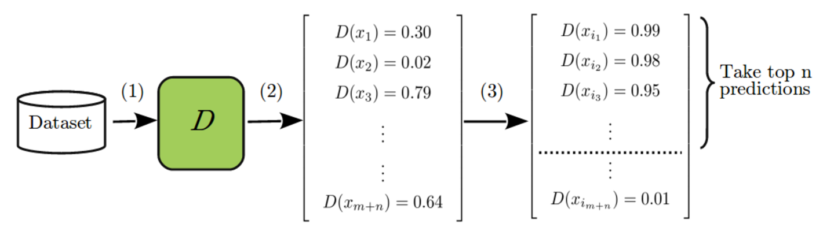
Each type of attack requires certain leakage of data
White-box: an adversary stole the discriminator
(the image is taken from [1])
Leaked data
Black-box attack + leakage of private data
Black-box attack without leakage: the structure of GAN is required for a successful attack
Homemade generator
Photo
Feedback
Homemade discriminator
Feedback
Homemade discriminator
Attacked generator
Photo
Attacked generator
Photo
1. J. Hayes , L. Melis , G. Danezis, E. De Cristofaro. LOGAN: Membership Inference Attacks Against Generative Models. Proceedings on Privacy Enhancing Technologies, 2019(1), pp.133-152

Slide 9
Even simplistic GANs are robust against white-box attacks
*

Slide 10
Even simplistic GANs are robust against black-box attacks (20% leakage)
*

Slide 11
Black-box attacks without leakages and knowledge about attacked GAN are ineffective
*

Slide 12
Results
Both Vanilla GAN and DCGAN replicate handwritten digits at the same quality. Vanilla GAN, however, demonstrates extreme robustness. DCGAN can be easily subverted once its structure is uncovered. Despite straightforwardness of the white-box attack, black-box attacks can also show high efficiency if particular information (the structure of the GAN or a fraction of the dataset itself) has flown to the adversary.
Simple structures show high robustness against them if one follows recommendations given in [1]: avoidance of overfitting, placing dropout layers, implementing proposed attacks before committing the network.

Slide 13
References
J. Hayes , L. Melis , G. Danezis, E. De Cristofaro. LOGAN: Membership Inference Attacks Against Generative Models. Proceedings on Privacy Enhancing Technologies, 2019(1), pp.133-152
J. Jordon, J. Yoon, M. van der Schaar. PATE-GAN: Generating synthetic data with differential privacy guarantee., https://openreview.net/pdf?id=S1zk9iRqF7 , 2019
M. Abadi, A. Chu, I. Goodfellow, H. B. McMahan, I. Mironov, K. Talwar, and L. Zhang. Deep learning with differential privacy. In CCS, 2016.
M. Arjovsky, S. Chintala, and L. Bottou. Wasserstein GAN. https://arxiv.org/pdf/1701.07875.pdf%20http://arxiv.org/abs/1701.07875.pdf , 2017.
Pretrained DCGAN for MNIST: https://github.com/csinva/gan-vae-pretrained-pytorch/tree/master/mnist_dcgan

Slide 14
Thanks for your attention!
Artur Sidorenko
Moscow State University, Faculty of Mechanics of Mathematics
a.sidorenko1998@yandex.ru

Slide 15
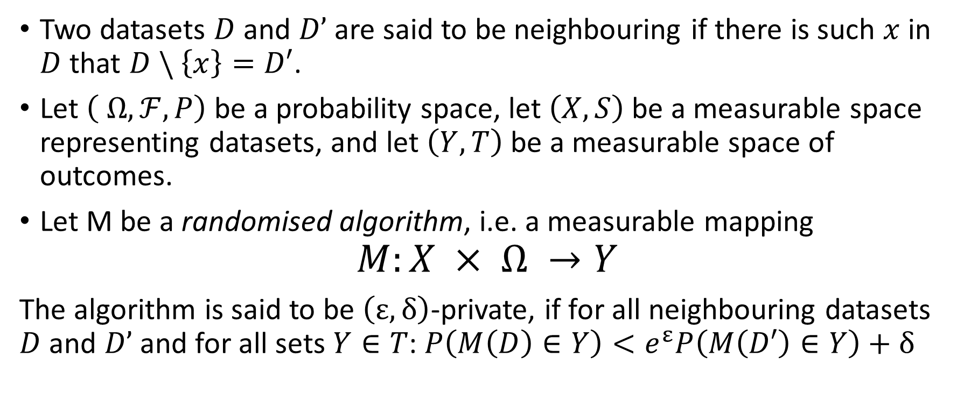
Differential privacy
Two datasets $D$ and $D’$are said to be neighbouring if there is such $x$ in $D$ that $D \backslash \left\{x\right\}=D′$.
Let $\left( Ω, ℱ, P\right)$ be a probability space, let $\left(X, S\right)$ be a measurable space representing datasets, and let $\left(Y, T\right)$ be a measurable space of outcomes.
Let M be a randomised algorithm, i.e. a measurable mapping
$$M:X × Ω →Y$$
The algorithm is said to be $\left(ε, δ\right)$-private, if for all neighbouring datasets $D$ and $D’$and for all sets $Y∈T$: $P\left(M\left(D\right)∈Y\right)<e^{ε}P\left(M\left(D′\right)∈Y\right)+δ$

Slide 16
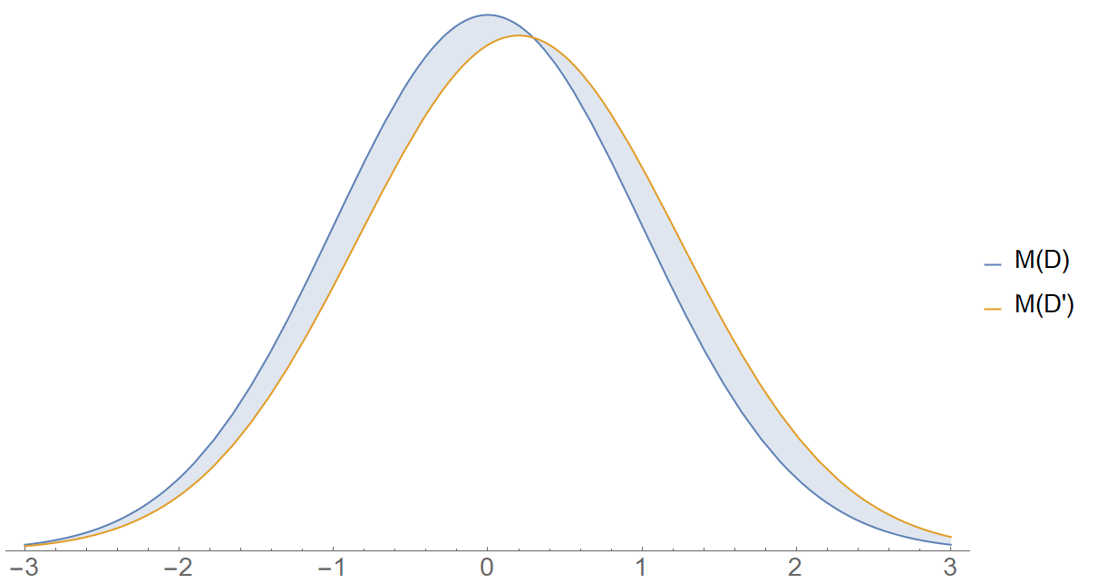
Differential privacy
Slight changes of the dataset do not cause significant difference in the distribution of the output
M: dataset -> PDF

